Slide 1
Verbetering van de Evidence Section
Drieam

Slide 2


Agenda
A
Inspiration
Review
Core Features
Difficulty Levels
Questions

Slide 3
Inspiration
Existing designs
Other e-portfolios
File management applications (mobile and desktop)
Study Coach (for dashboard examples)
Eduframe tables
Your feedback on previous versions
Notes:
All these are an inspiration not just for the look but for some added features too.

Slide 4
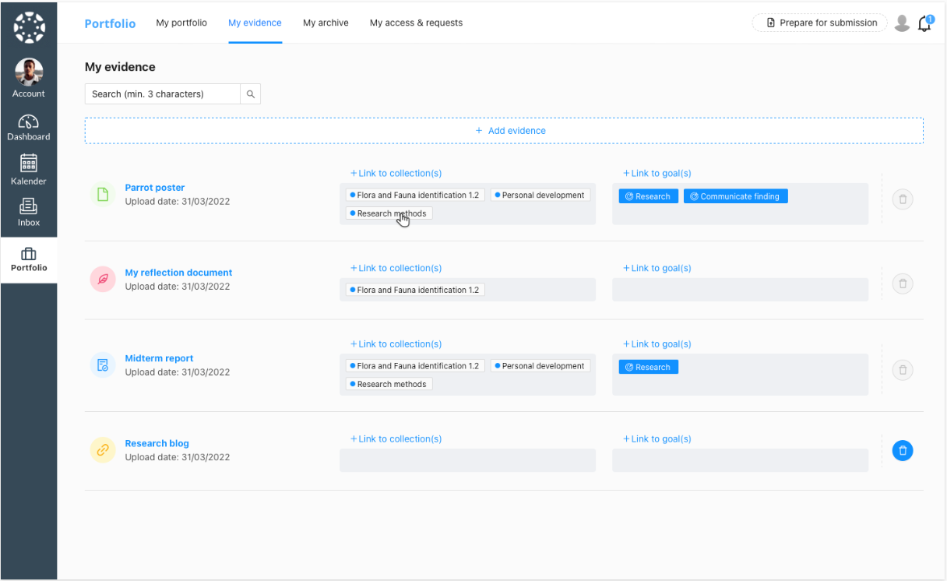
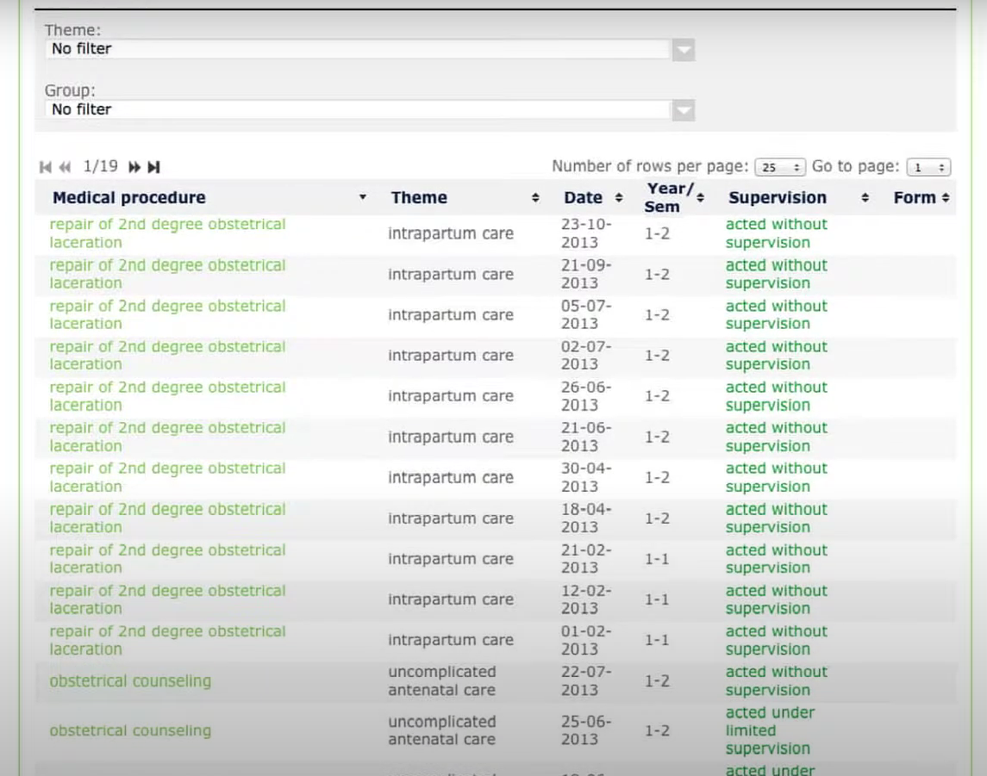
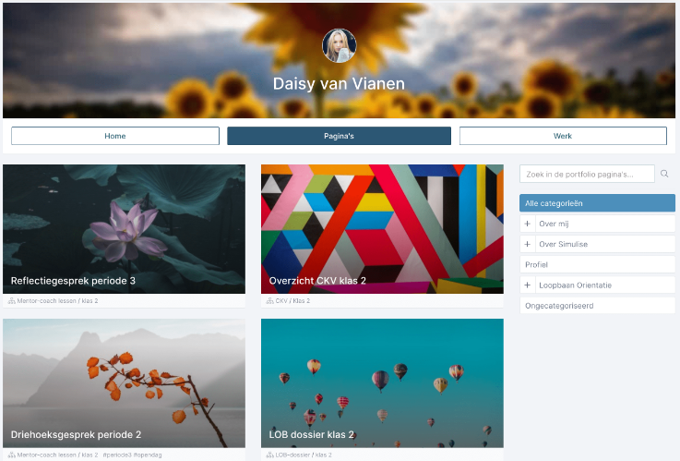
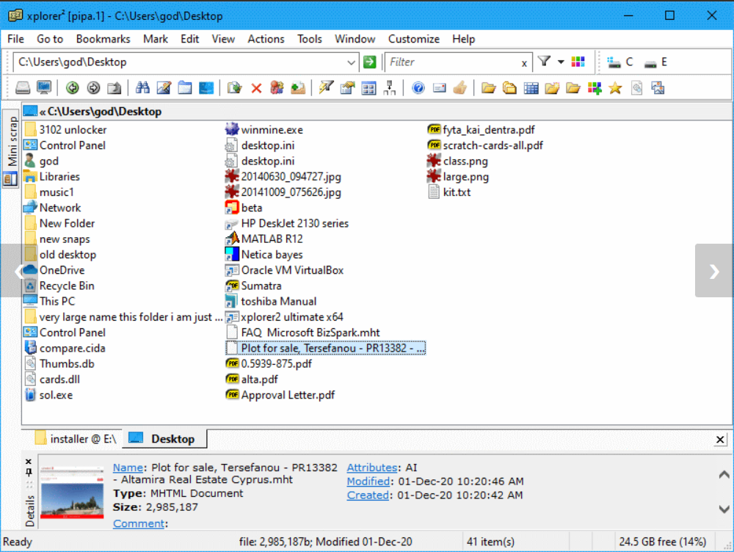
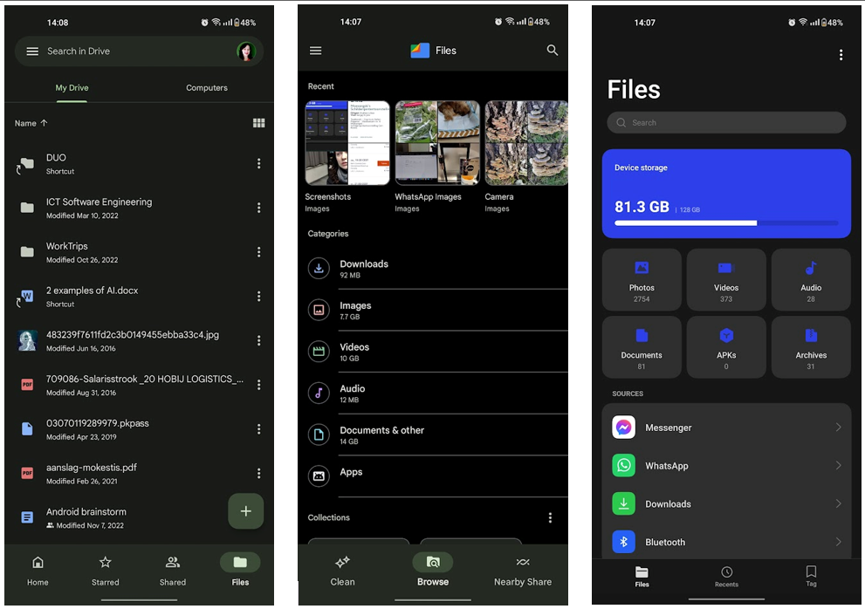
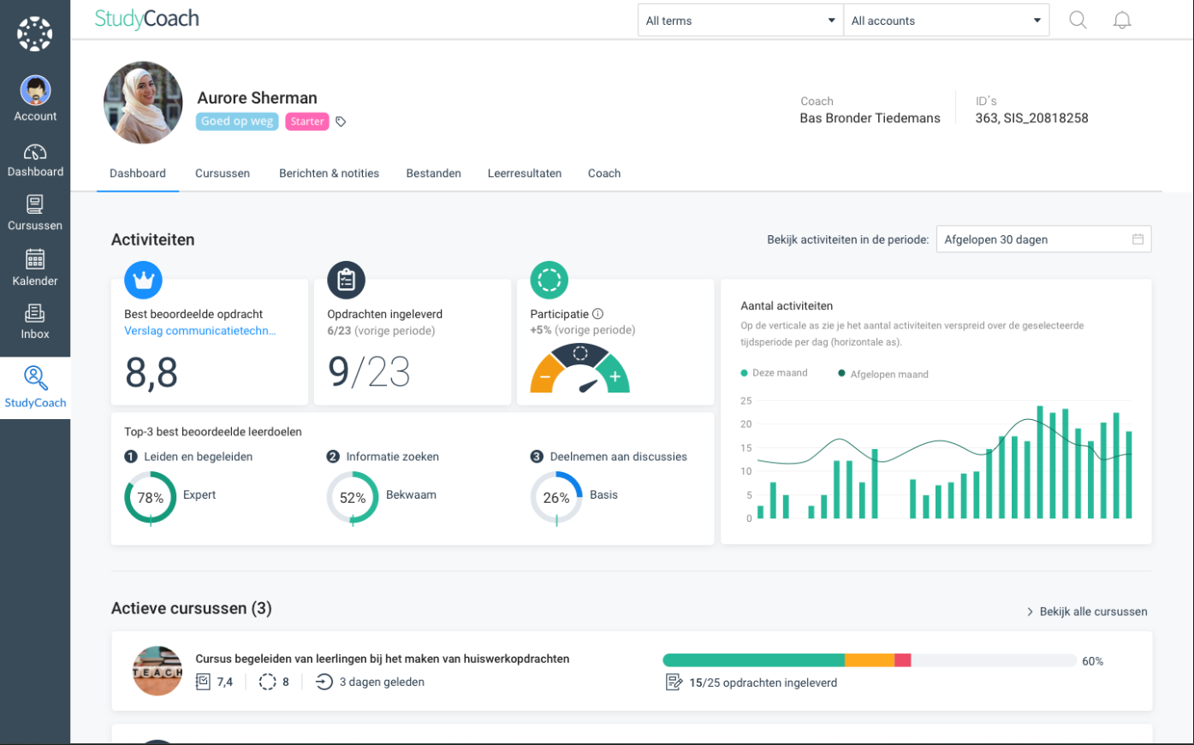
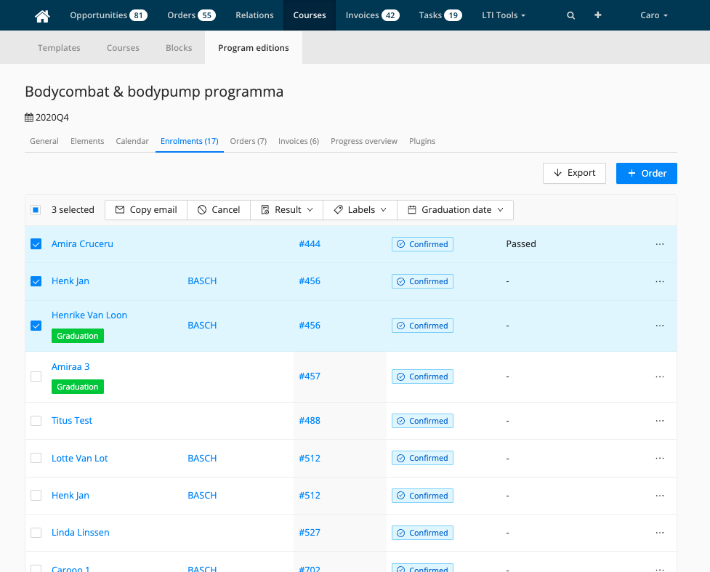
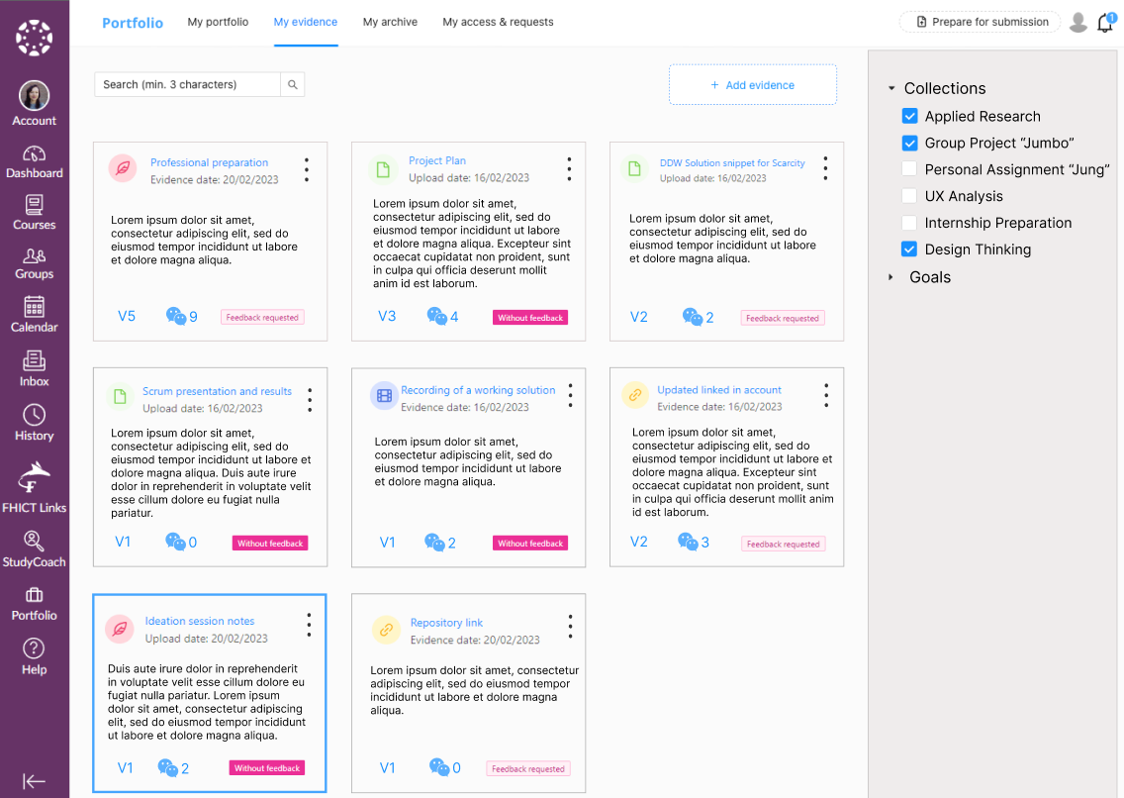

Slide 5
Design Review
V5 V6 V7

Slide 6
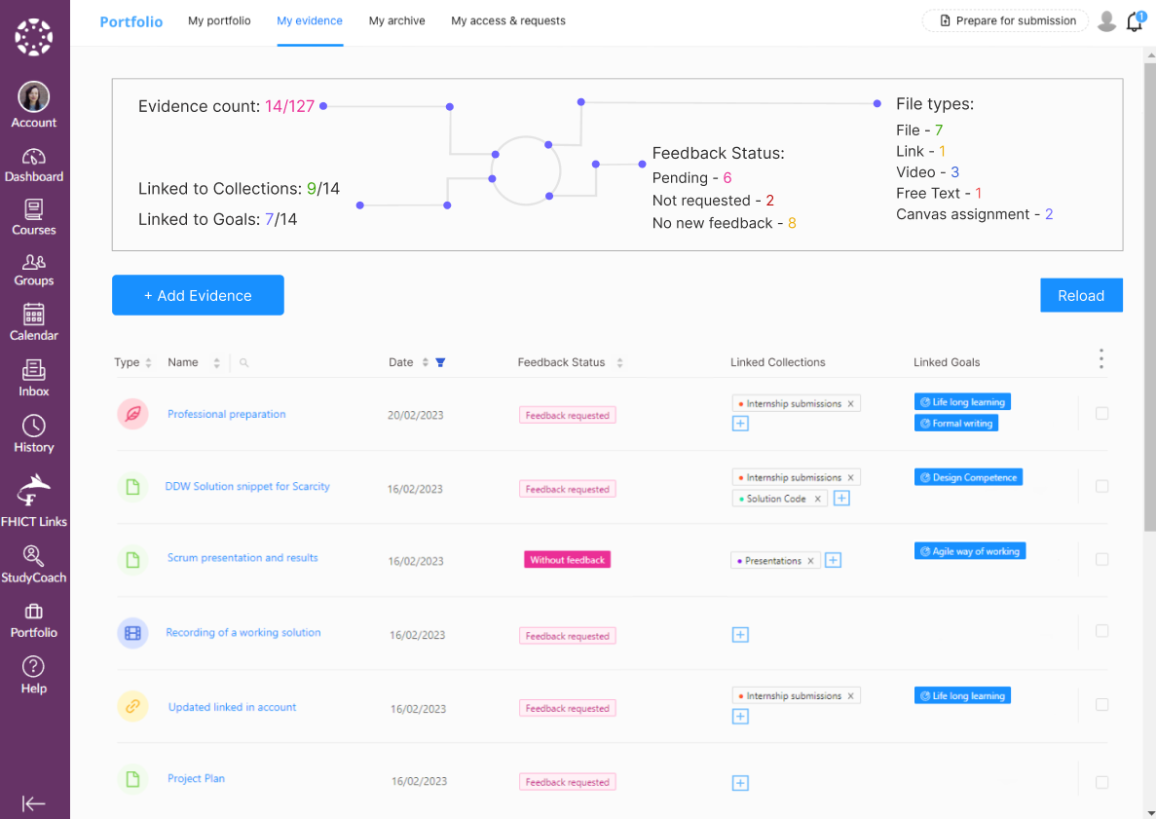

Slide 7
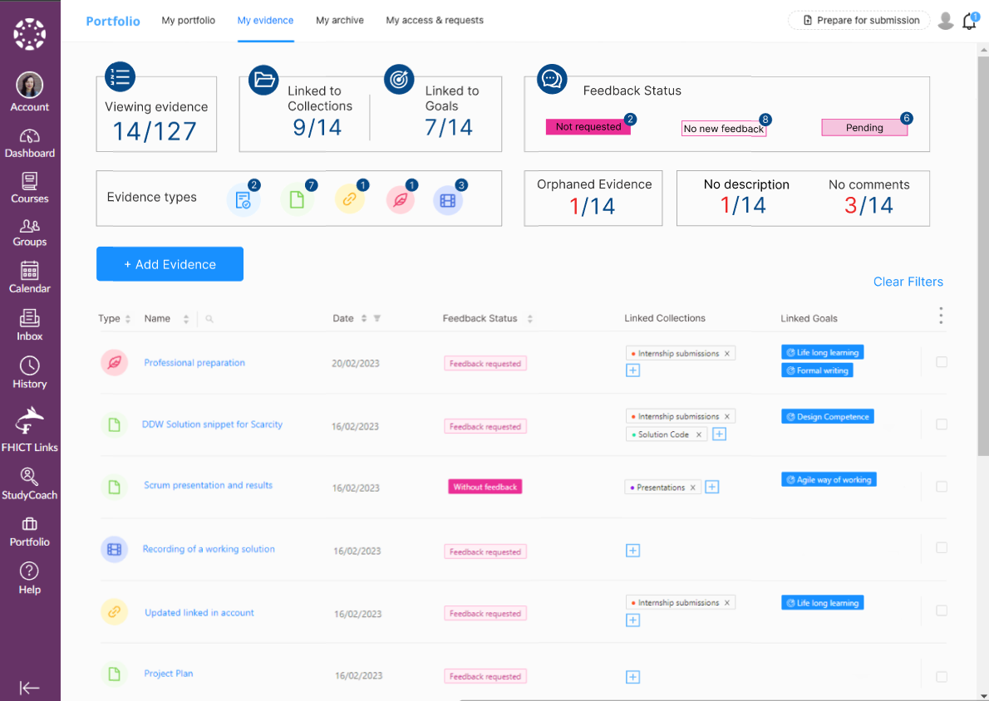

Slide 8
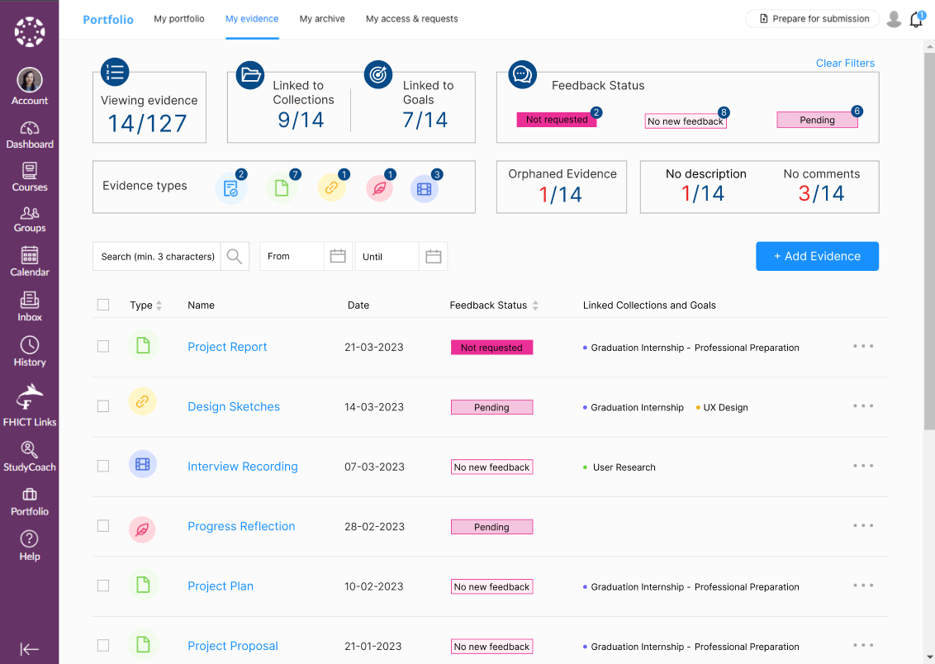

Slide 9
Core Features
F
The table
Search by name
Filter by date
Sort by type and feedback status
Display collections and Goals
Option to add / remove from overview
Bulk delete
The dashboard
Static counter dashboard for general overview
Interactive Dashboard
Dynamic dashboard

Slide 10
Levels of Difficulty
I'm Too Young to Die
Making the table a little smarter
Hey, Not Too Rough
Fully Smart table
Hurt Me Plenty
Smart Table with a static Dashboard
Interactive Dashboard
Ultra-Violence
Nightmare!
Dashboard that updates with each Smart table action

Slide 11
Questions
Should the dashboard part be always visible?
What if it would appear after reaching certain number of evidence or once they no longer in one page?
Can we build it under a feature-flag?
How to clear the filters? Should it be hidden or disabled when no filter is applied?

Slide 12
Thank you
Edita​ Pronckute

